Slide 1
Top 10 Methods and Statistics “Issues” in Academic Emergency Medicine Craig Newgard, MD, MPH May 17, 2013

Slide 2
Goals
Summarize: methods and statistics problems with AEM submissions
Promote: high-quality research with valid results that push the science of emergency care forward

Slide 3
How this list was compiled and where to seek out solutions
Query of AEM editors and reviewers
AEM Editorial Board
AEM Statistical Reviewers
AEM Senior Editors Group
Solutions: AEM Statistics and Methodology Virtual Issue http://onlinelibrary.wiley.com/journal/10.1111/(ISSN)1553-2712/homepage/statistics_and_research_methodology.htm
16 categories of methods and stats topics
49 linked references from AEM, Annals and PEC
77 additional references

Slide 4
1. Study objective, mis-matched methods
No clearly stated study objective
Analysis doesn’t respond to the study question
Objective not addressed in Results
Methods and statistics do not appear appropriate for question at hand
Inappropriate sample recruited
Incorrect variables
Inappropriate model for the data
Overly simplistic methods for study question
No control group for comparative testing

Slide 5
2. Sample problems
Sample used for analysis does not represent target population
Inappropriate inclusion/exclusion criteria
Convenience sampling
Failure to explain why particular sample size was used
Convenience
Data availability
Time span
Changes in data collection or other processes (e.g., natural experiments)
Sample size calculation?
Too small to address study question
All primary prospective studies should have a sample size calculation
How did you know when to stop enrolling?

Slide 6
3. Outcomes
Why was this outcome selected? Is it meaningful?
Post-test scores in education research
Out-of-hospital outcomes (early, intermediate)
Asking participants if they “liked it”
Validated outcome?
Surrogate or proxy outcome?
Same outcome as used for sample size calculation?
Authors focus on secondary outcome

Slide 7
4. Variables
Failure to collect key variable(s) for addressing study question
Missing key confounders
Selecting inadequate proxy variable
E.g., interest in quality of life, use mortality as outcome

Slide 8
5. Missing values
Failure to address missing data
% missing for key variables (outcome, predictors)
How were missing data handled?
Throw out subjects with missing values (complete case analysis)
Multiple imputation
Other
Sensitivity tests to address concerns?
Are the study results valid?

Slide 9
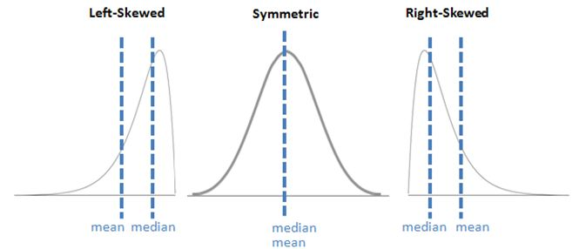
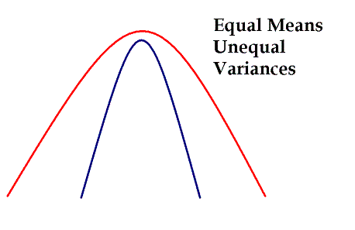
6. Inappropriate statistical tests
Parametric vs. non-parametric testing
Key assumptions for parametric tests:
Populations are normally distributed
Homogeneity of variance
Handling clustered data
Generalized estimating equations
Random effects models
Fixed effects models
Hierarchical models (Bayesian analyses)

Slide 10
7. Modeling
What was the primary reason for using a multivariable regression model?
How does the model relate to the study objective(s)?
Why did you choose a certain type of model?
How did you choose candidate variables for the model?
A priori selection
Known or plausible confounders
Univariate testing
Rules of thumb for total # variables (e.g., 10:1 for logistic regression)
Automated variable section (forward or backward) = poor strategy
Model diagnostics?
Goodness of fit
Discrimination
Variance explained (e.g., R-squared)

Slide 11
8. P values vs. confidence intervals
CI offer more information
P values very limited in utility, scope
P values may have role in certain types of studies
RCT following power calculation
Testing for interactions
No need for both
Table 1 often primarily descriptive
Baseline characteristics
No need for statistical testing
Exception: Comparative assessment of groups (e.g. RCT)

Slide 12
9. Tables and Figures
Tables don’t add up
Duplication of results in text and tables/figures
redundancy, failure to use space wisely
Tables and figures don’t address primary study objective
Authors got lost somewhere along the path
Overly simplistic or inappropriate figures

Slide 13
10. Over-reaching conclusions
Conclusions not supported by the data
Over-state importance of study
Failure to recognize key limitations of the study
Substitute statistical significance for clinical importance
Problems interpreting RCT results
Superiority vs. equivalence vs. non-inferiority

Slide 14
Questions?

